Slide 1

Informatitek Capstone 2
2016-2020 SAIPE School Poverty Analysis
Presented by: Monique Brown
June 8, 2022

Slide 2

Small Area Income and Poverty Estimates (SAIPE) School District Estimates for 2016 – 2020
About the datasets…
How is poverty measured?
U.S Census Bureau determines poverty status by using an official poverty measure (OPM) that is calculated using three elements – income, threshold, family size (How Is Poverty Measured? – INSTITUTE FOR RESEARCH ON POVERTY – UW–Madison, 2022)
What do these datasets encompass?
These datasets encompass the small area income and poverty population estimates for each school district in the United States for students ages 5-17 years old

Slide 3
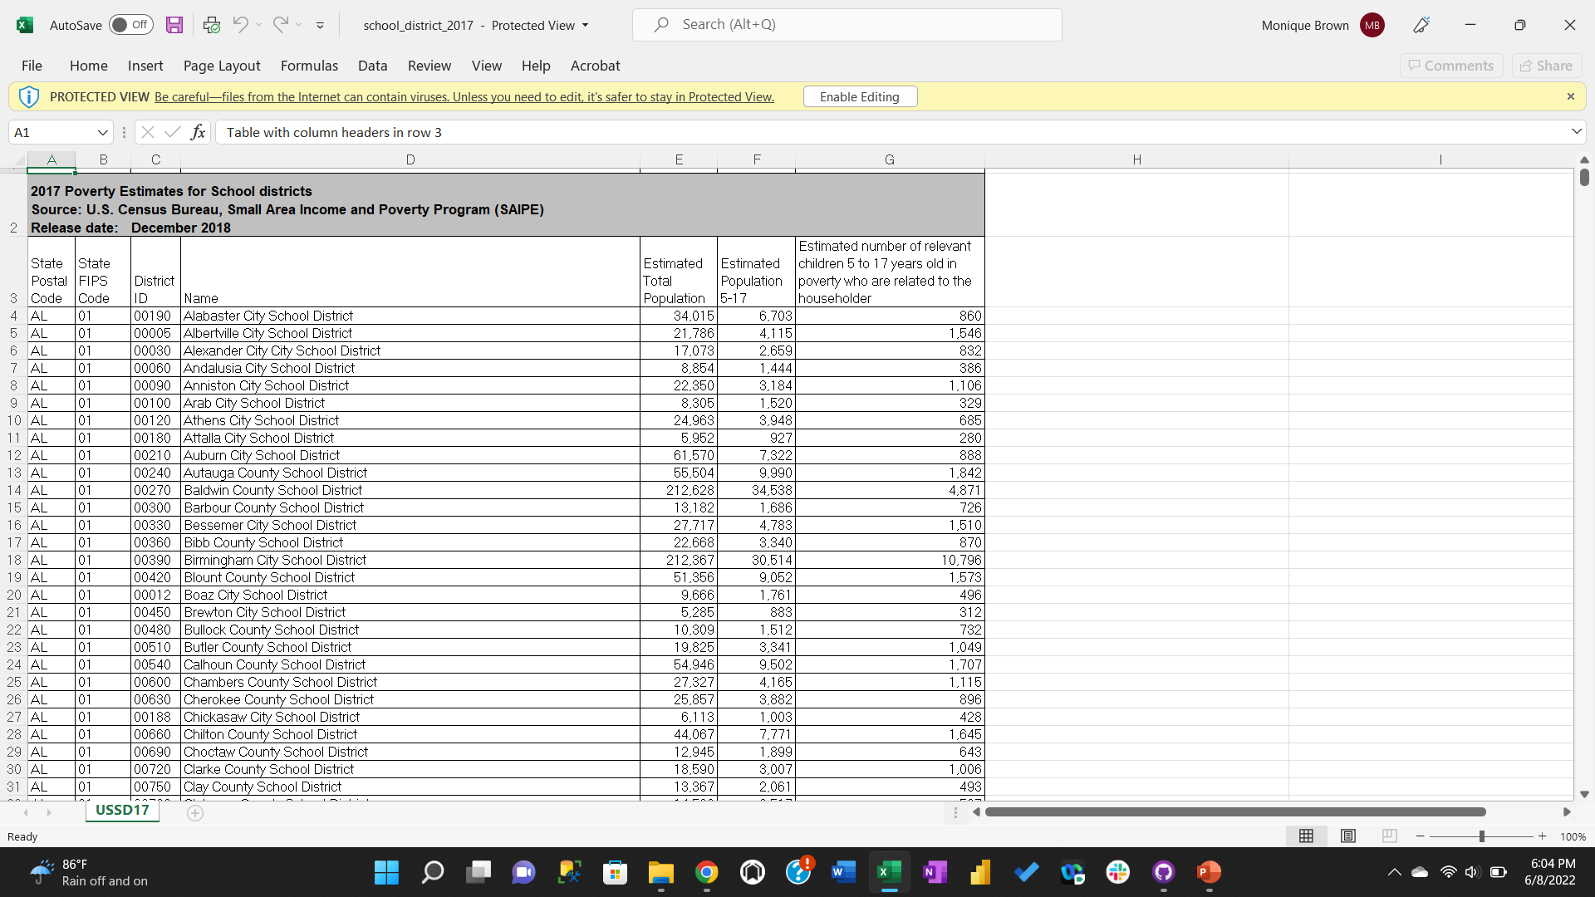
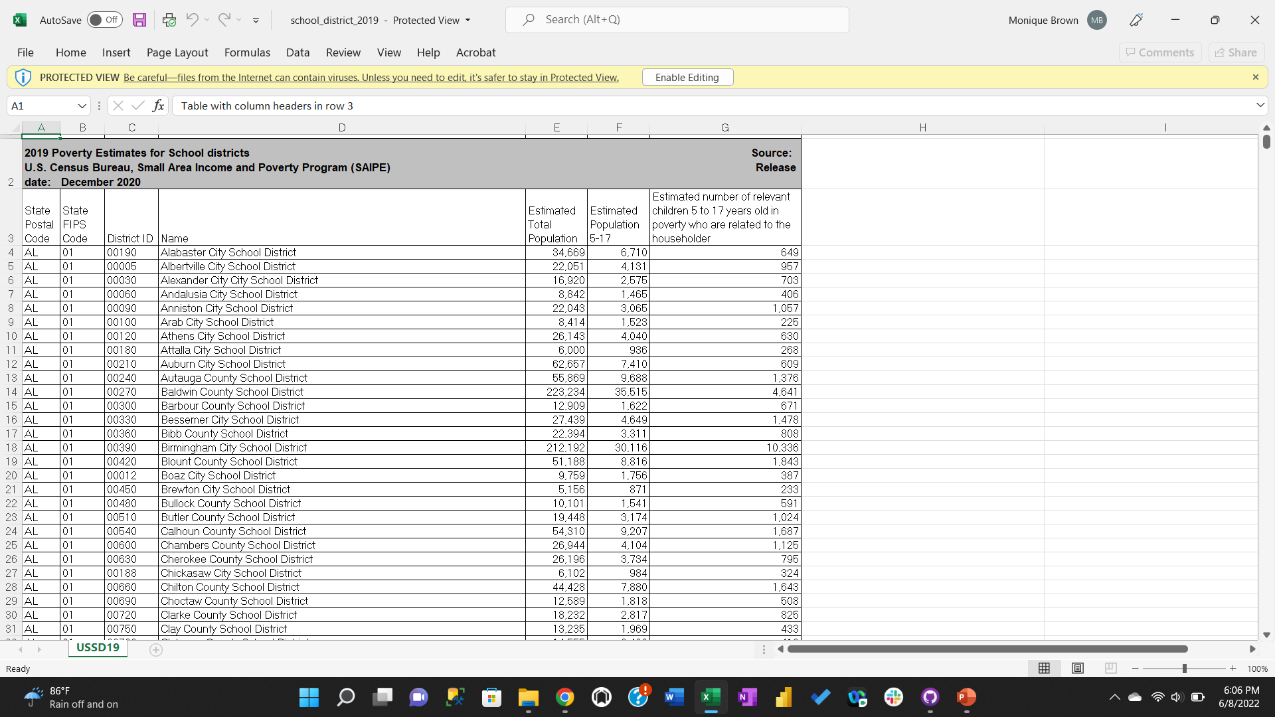

Snapshots of SAIPE School District Data
Source: U.S Census Bureau (https://www.census.gov/programs-surveys/saipe/data/datasets.2016.List_1743592724.html)

Slide 4
Power BI Dashboard
Let’s analyze some data!

Slide 5
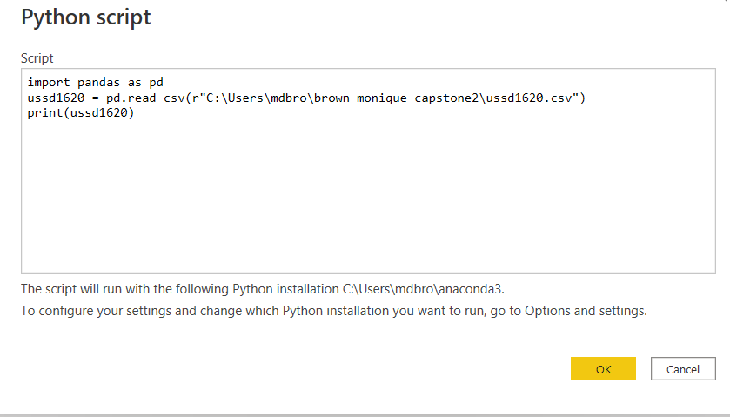
Python Integration
How was python used in relation to Power BI?
Python and pandas code were used to import the CSV file USSD1620 (contained merged data tables) in which were then loaded into Power BI for further analysis

Slide 6
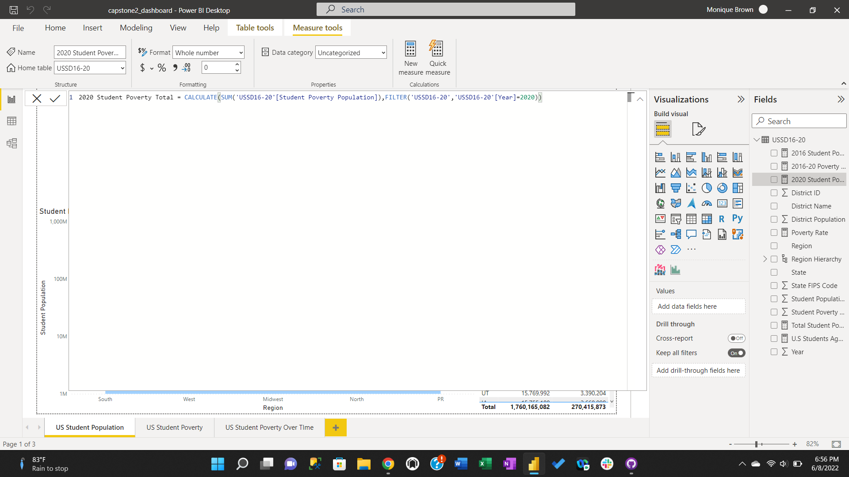
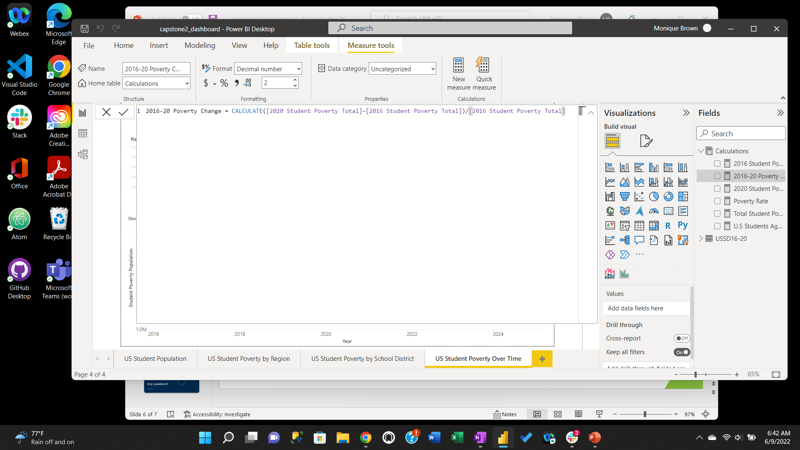
Power BI DAX Functions
How were DAX functions utilized on the dashboard?
DAX functions were used to create measures used for data analysis This is one of the measures created using DAX functions, this measure takes the total sum of students in poverty for the year of 2020
DAX functions were used to create measures used for data analysis This is another measure created using DAX functions, this measure takes the total sum of students in poverty for the year of 2020 and subtracts from the total amount of students in poverty in 2016 measure and divides by the 2016 student poverty population to calculate the rate of change over the 4 years

Slide 7
Any questions?
Thank you!

